Slide 1
Ideal Business in Sao Paulo, Brazil
Rafael Sakuma

Slide 2
Problem/Opportunity
Sao Paulo is vibrant, cosmopolitan, city of 21 million inhabitants (considering the metropolitan area). It is also a place where cultures from all over the world have congregated and as such created a diverse city.
It is the biggest city in terms of population, the richest in the country and the second one in terms of HDI.*
As such, there are many opportunities here and I will be analyzing what are good options for opening a business in the city.

Slide 3
The Data
I got my data for the venues in the city from the Foursquare API.
I got my city data from a geo_json filed I downloaded from a project in GitHub, which contained:
District Name
Geometric Coordinates

Slide 4
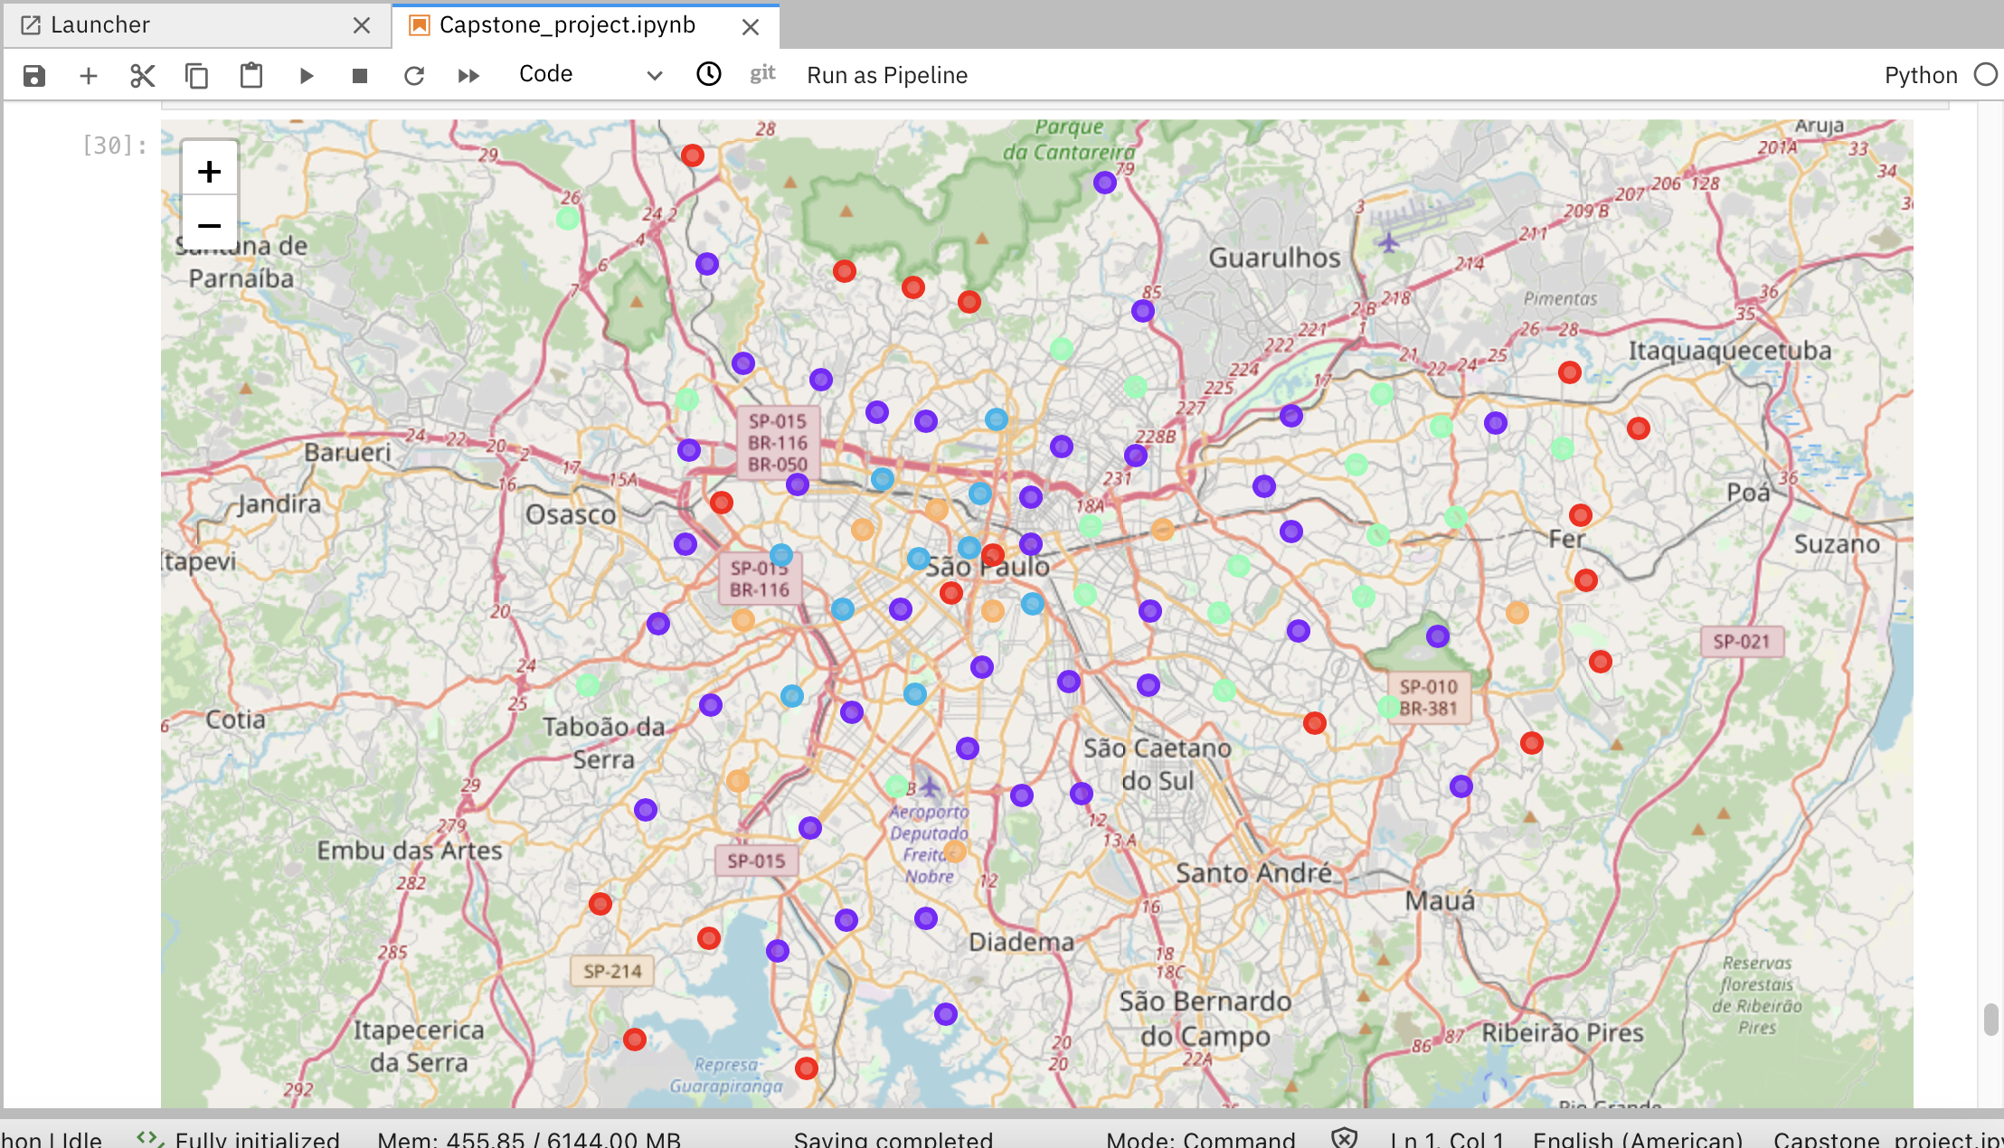
Map

Slide 5
Results
Red: Cluster 0
Mixed Districts (Lots of different business activity)
Purple: Cluster 1
Mixed Districts (Lots of different business activity)
Blue: Cluster 2
Business Districts (Offices)
Light Green: Cluster 3
Mixed Districts (Lots of different business activity)
Orange: Cluster 4
Residential Districts (Apartments/houses)

Slide 6
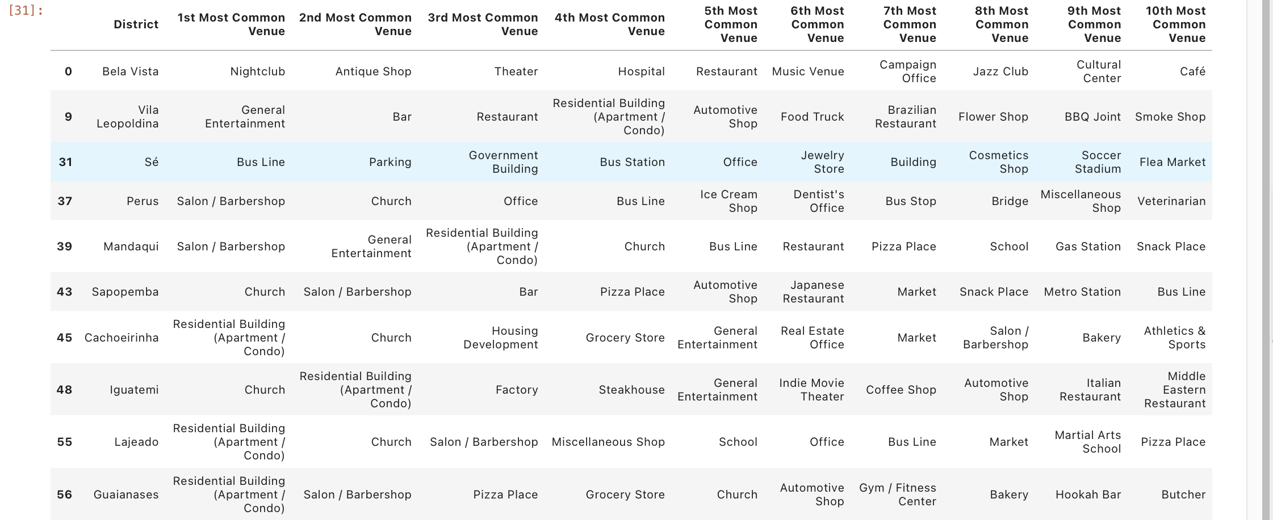
Cluster 0

Slide 7
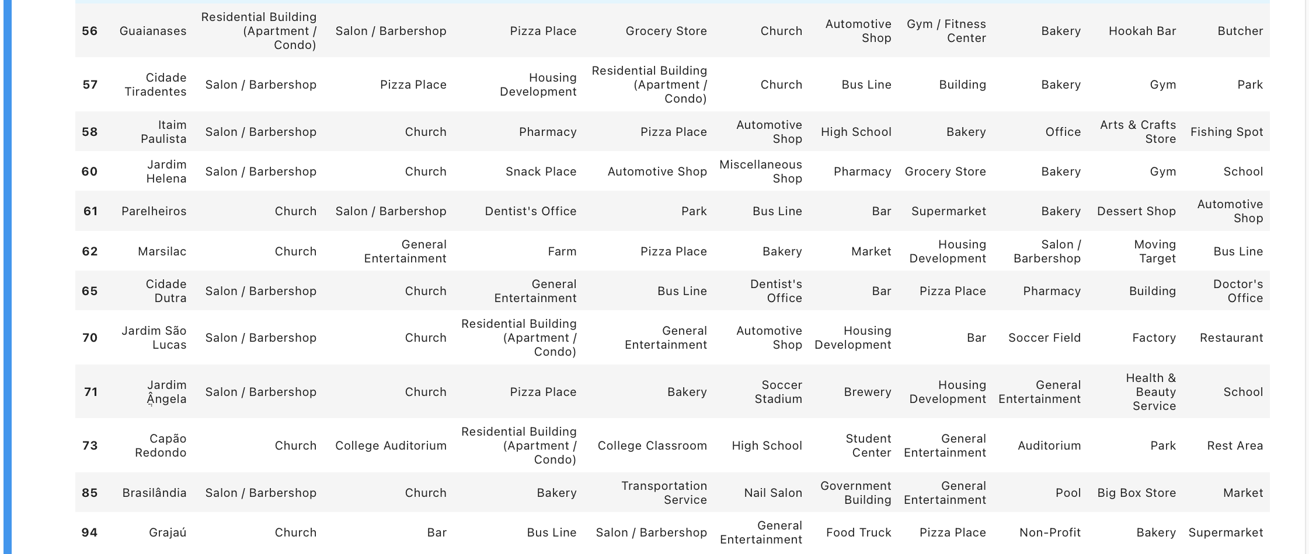
Cluster 0 (cont.)

Slide 8
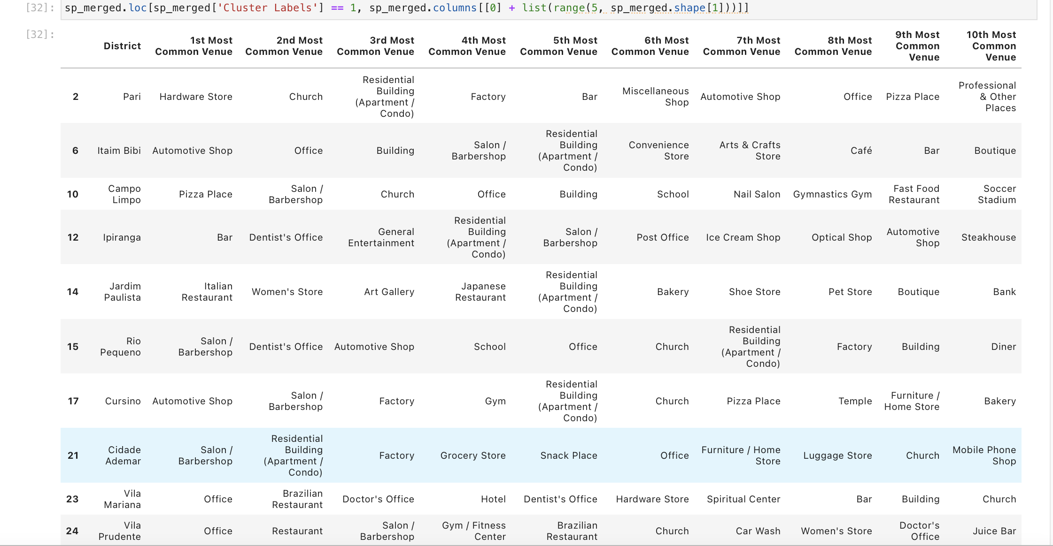
Cluster 1

Slide 9
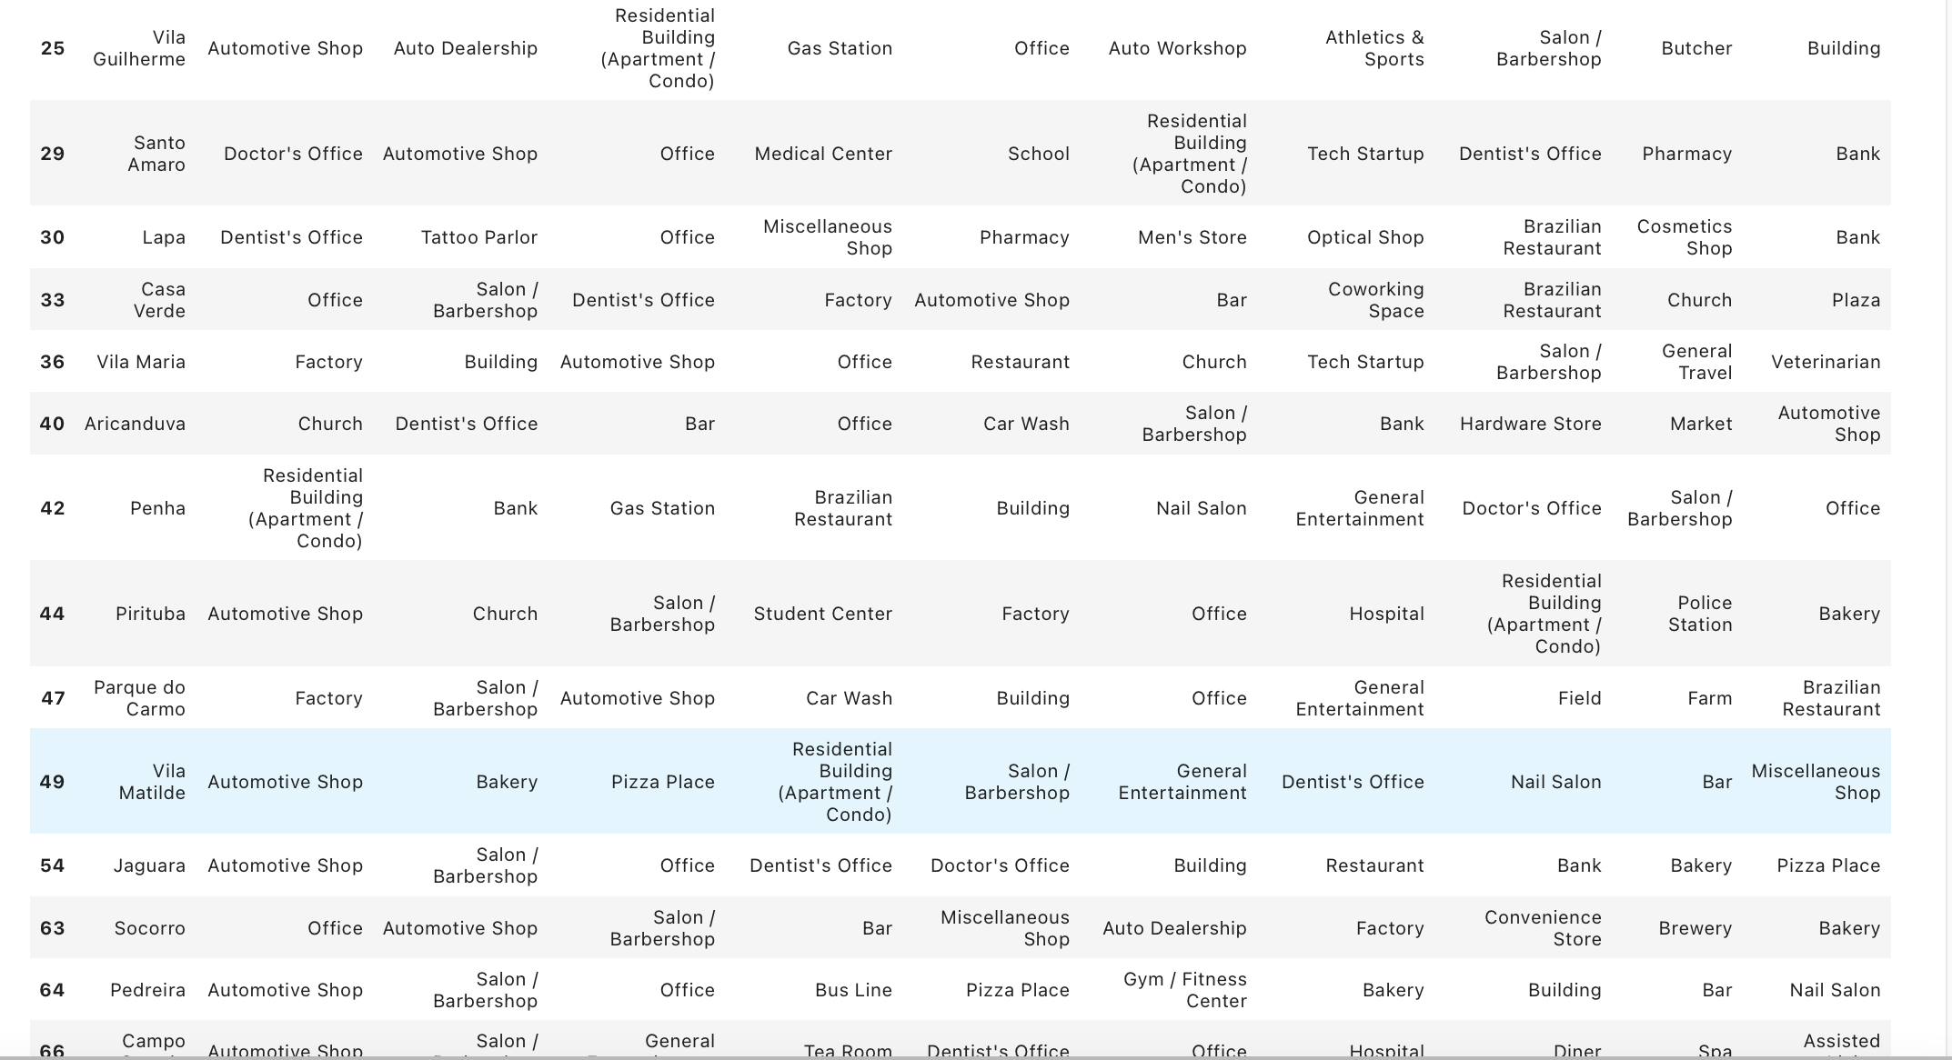
Cluster 1 (cont.)

Slide 10
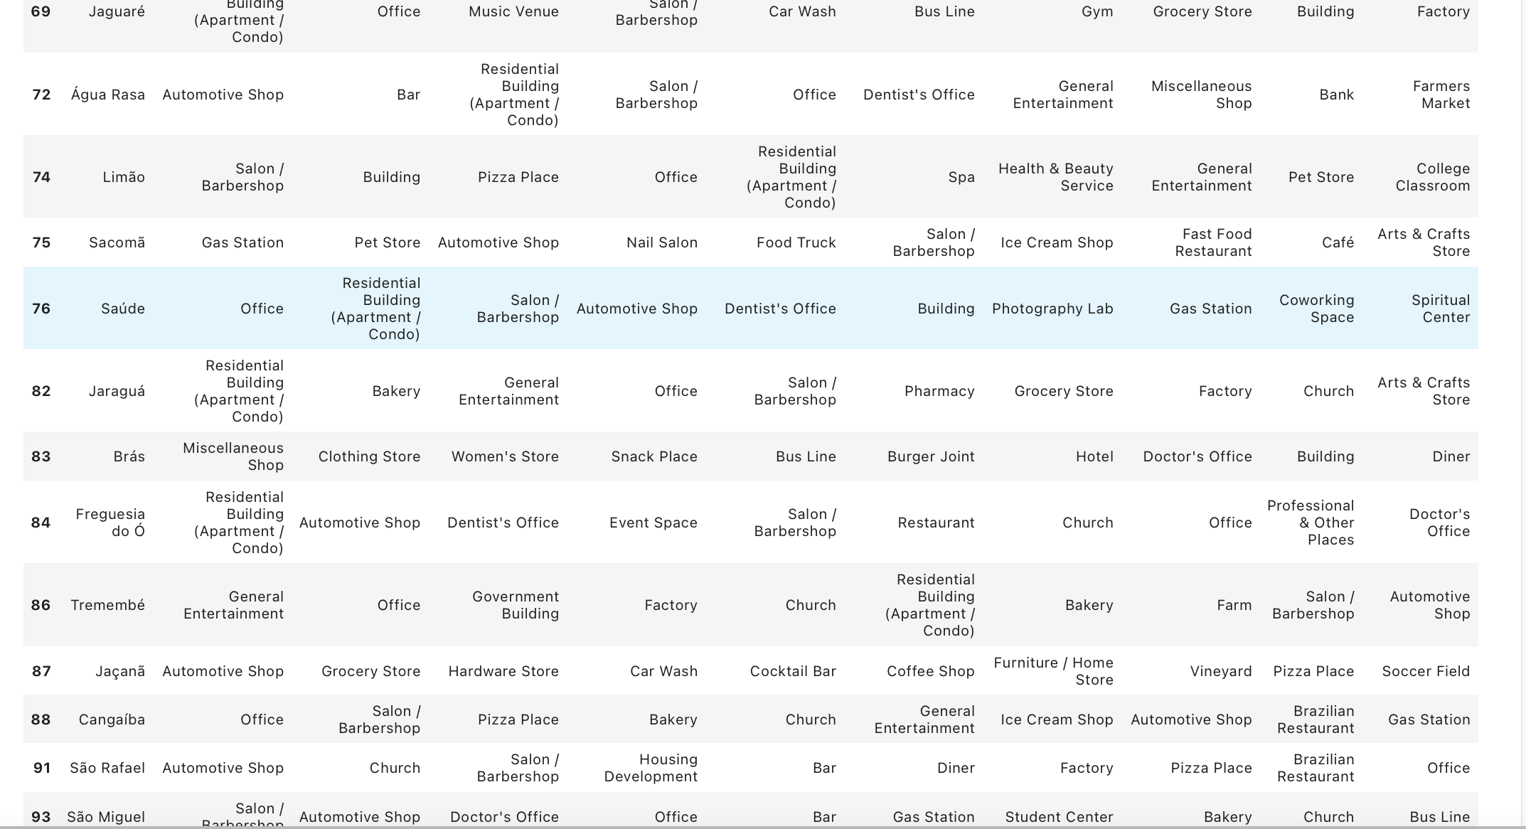
Cluster 1 (cont.)

Slide 11
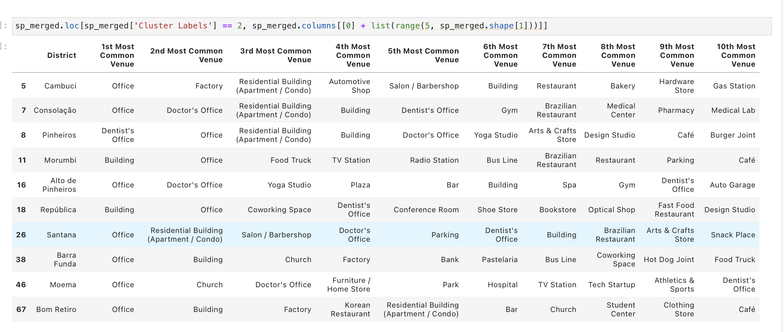
Cluster 2

Slide 12
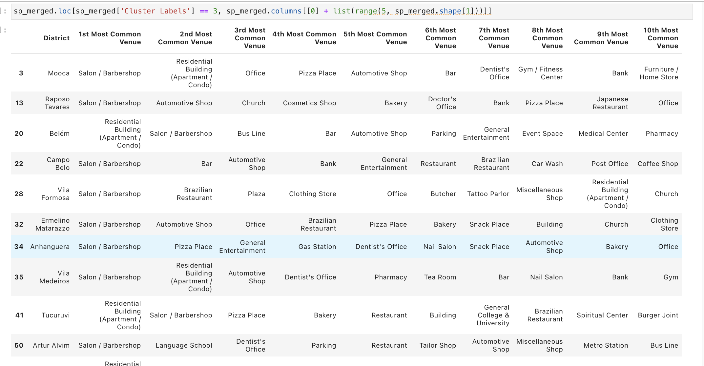
Cluster 3

Slide 13
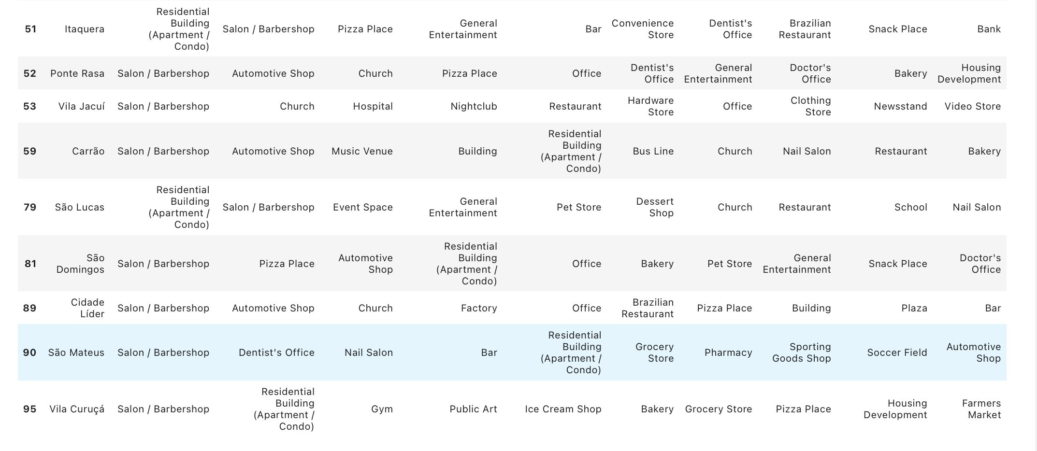
Cluster 3

Slide 14
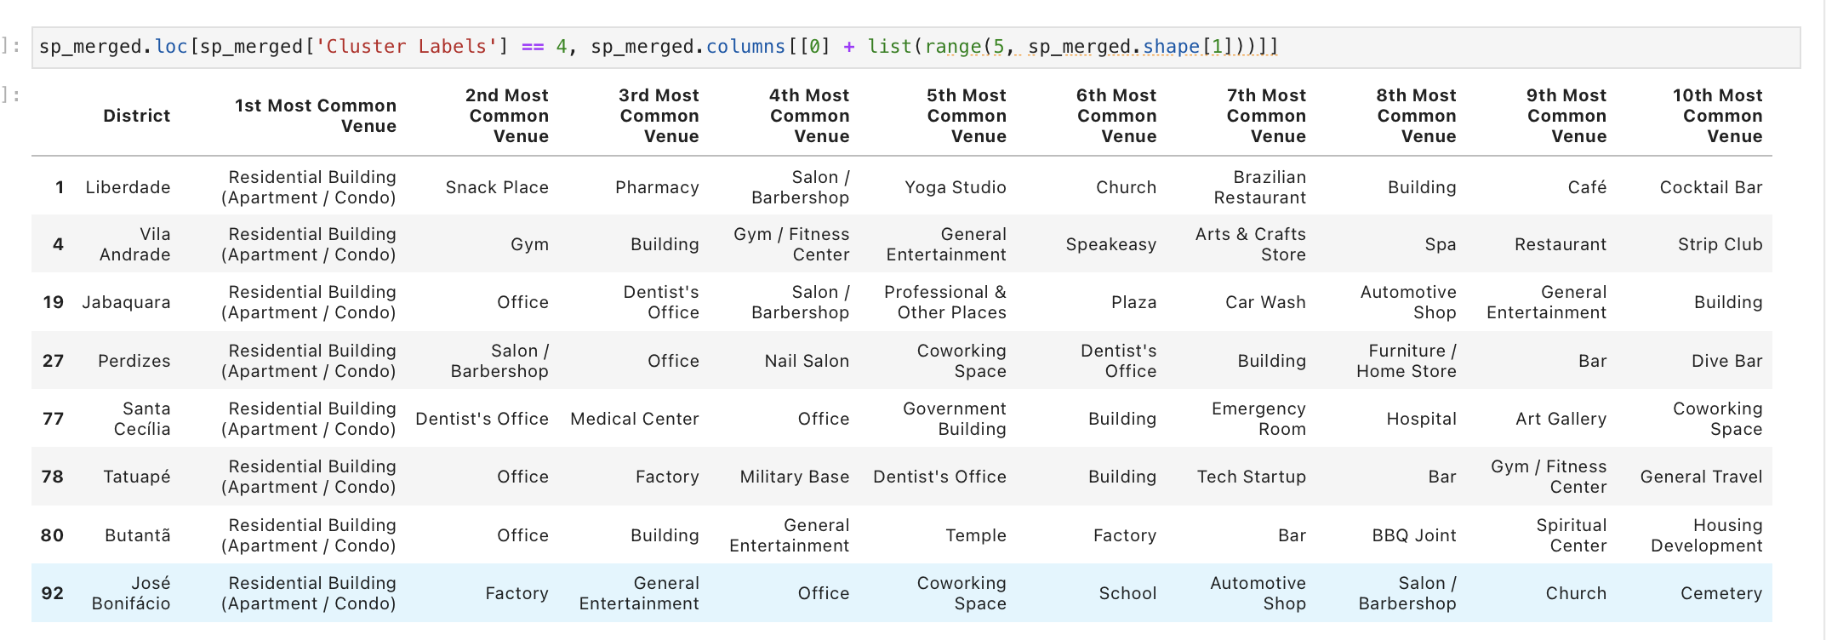
Cluster 4

Slide 15
Verdict
Cluster 2: Primarily business district
Gyms and fitness centers
Not much competition, like restaurants.
Easy access to people who commute and want to optimize their time.
Cluster 4: Primarily residential district
Restaurants
Not much competition.
Lots of potential clientele as people live close-by.
Easy access for residents who might want to dine somewhere close.
Clusters 0,1 and 3: Mixed districts
Require a more in-depth assessment of activities carried out in there.

Slide 16
THE END

